Slide 1
Decision tree
Session 21
Henry Lucky, S.Kom., M.Kom.

Slide 2
Learning Outcomes
Session 21
At the end of this session, students will be able to:
LO 5: Apply various learning algorithms for agents to solve problems

Slide 3
outline
Session 21
Rule-based learning
Tree terminology
Decision Tree

Slide 4
Rule-based learning
definition
Rule-based learning is a term in computer science intended to encompass any machine learning method that identifies, learns, or evolves 'rules' to store, manipulate or apply
The defining characteristic of a rule-based machine learner is the identification and utilization of a set of relational rules that collectively represent the knowledge captured by the system.
While rule-based machine learning is conceptually a type of rule-based system, it is distinct from traditional rule-based systems, which are often hand-crafted, and need prior domain knowledge.
  Rule-based learning applies some form of learning algorithm to automatically identify useful rules

Slide 5
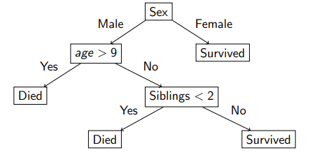
Rule-based learning
Decision tree rules
There are many example of rule-based learning algorithm, one of them is decision tree.
Let’s say we make a decision tree based on the Titanic Survivability data, which has the features: Sex, Age, and Siblings.

Slide 6
Rule-based learning
Decision tree rules
Here, we can see 4 rules:
  IF Sex is Female, THEN Survived
  IF Sex is Male AND Age > 9, THEN Died
  IF Sex is Male AND Age <= 9 AND Siblings < 2, THEN Died
  IF Sex is Male AND Age <= 9 AND Siblings >= 2, THEN Survived.

Slide 7
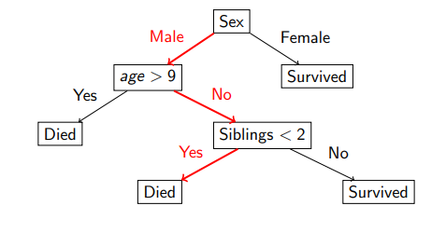
Rule-based learning
Decision tree rules
What happens if there is a male aged 6 years old with 0 siblings?
  Based on the data and the rules made, he would have died.

Slide 8
Rule-based learning
Decision tree
A decision tree is a rooted directed acylic graph.
The leaf nodes represent classes or values.
For the moment all of our classifications will be categorical.
An assignment of variables gives a path in the tree. The resulting classification is the value in the leaf node.

Slide 9
Rule-based learning
Decision tree
Decision tree algorithms can be considered as an iterative, top-down construction of the hypothesis; picture a hierarchy of decision, forking the dataset into subspaces.
Can represent any Boolean (binary) function, and the hypothesis space being searched is the entire space of Boolean functions
Considering only binary (or Boolean) features, at each node, there 2m potential splits to be evaluated given m features

Slide 10
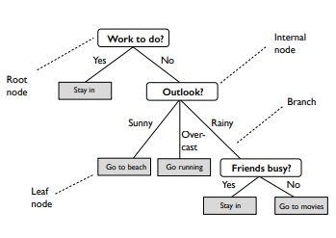
Tree-terminology
terminology
Root node: no incoming edge, zero or more outgoing edges.
Internal node: one incoming edge, two (or more) outgoing edges.
Leaf node: each leaf node is an assigned a class label (if nodes are pure; otherwise, majority vote).
Parent and child nodes: If a node is split, we refer to that given node as the parent node, and the resulting nodes are called child nodes, respectively.

Slide 11
Decision tree
Algorithms
Decision Tree learning is a method that attempts to find approximation functions that are discrete-valued and robust to noisy data and able to learn disjunctive expressions.
There are several decision tree algorithm:
  Iterative Dychotomizer 3 (ID3)
  C4.5
  Assistant
In this session, we will learn about ID3 algorithm

Slide 12
Decision tree
ID3 Algorithm
The ID3 algorithm attempts to build a top-down decision tree, starting with the question "Which attribute should be checked first and placed at the root?“
The question above will be answered by evaluating all attributes using information gain to measure the effectiveness of an attribute.

Slide 13
Decision tree
ID3 Algorithm
General Based Decision Tree Algorithm:
  The process of growing a decision tree can be expressed as a recursive algorithm as follows:
    Pick the feature that when parent node is split, it results in the largest information gain
    Stop if child nodes are pure or no improvement in class purity can be made
    Go back to step 1 for each of the two child nodes

Slide 14
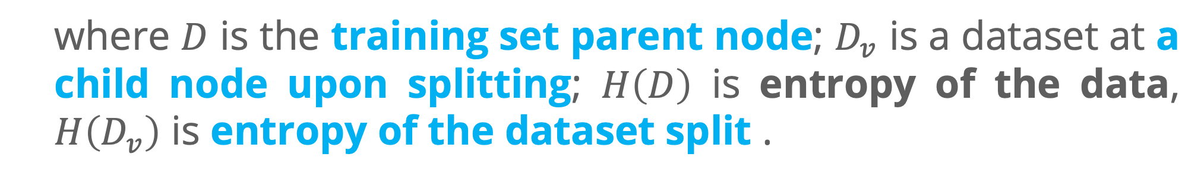
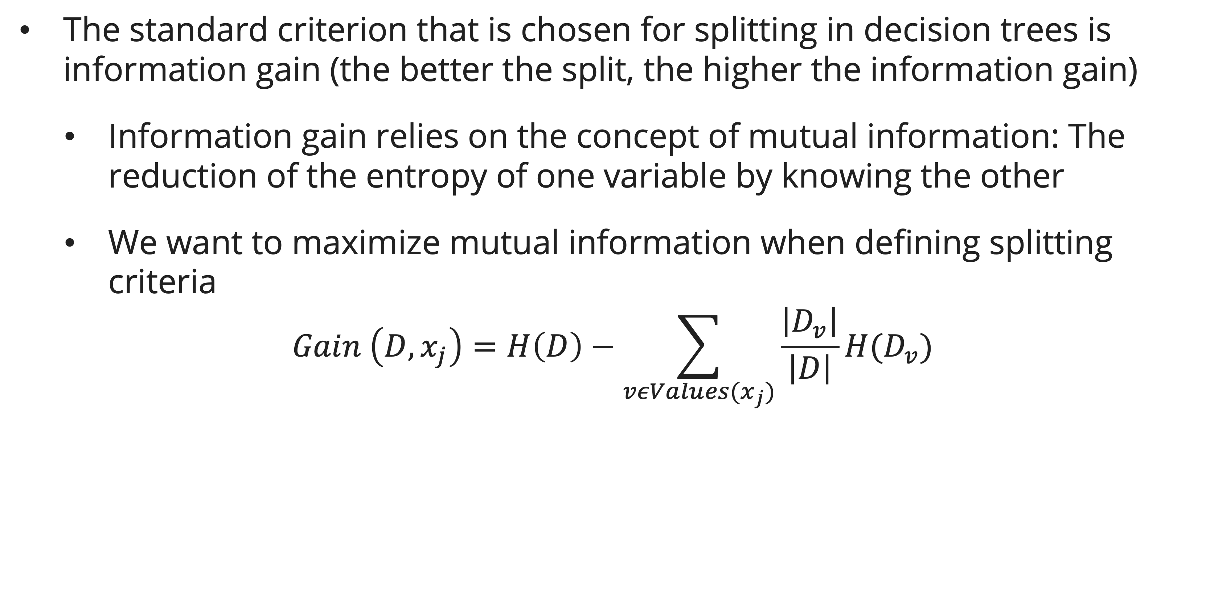
Decision tree
ID3 Algorithm: Information Gain
The standard criterion that is chosen for splitting in decision trees is information gain (the better the split, the higher the information gain)
  Information gain relies on the concept of mutual information: The reduction of the entropy of one variable by knowing the other
  We want to maximize mutual information when defining splitting criteria
$$Gain \left(D,x_{j}\right)=H\left(D\right)−\sum_{vεValues(x_{j})}{\frac{\left|D_{v}\right|}{\left|D\right|}H(D_{v})}$$
  where $D$ is the training set parent node; $D_{v}$ is a dataset at a child node upon splitting; $H\left(D\right)$ is entropy of the data, $H\left(D_{v}\right)$ is entropy of the dataset split .

Slide 15
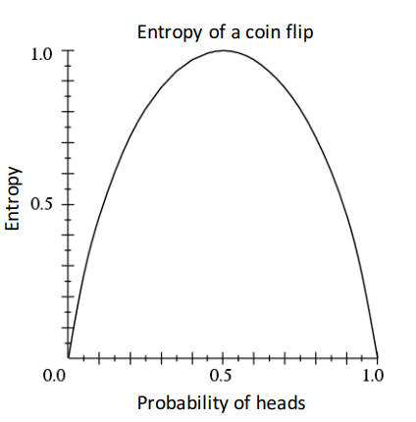
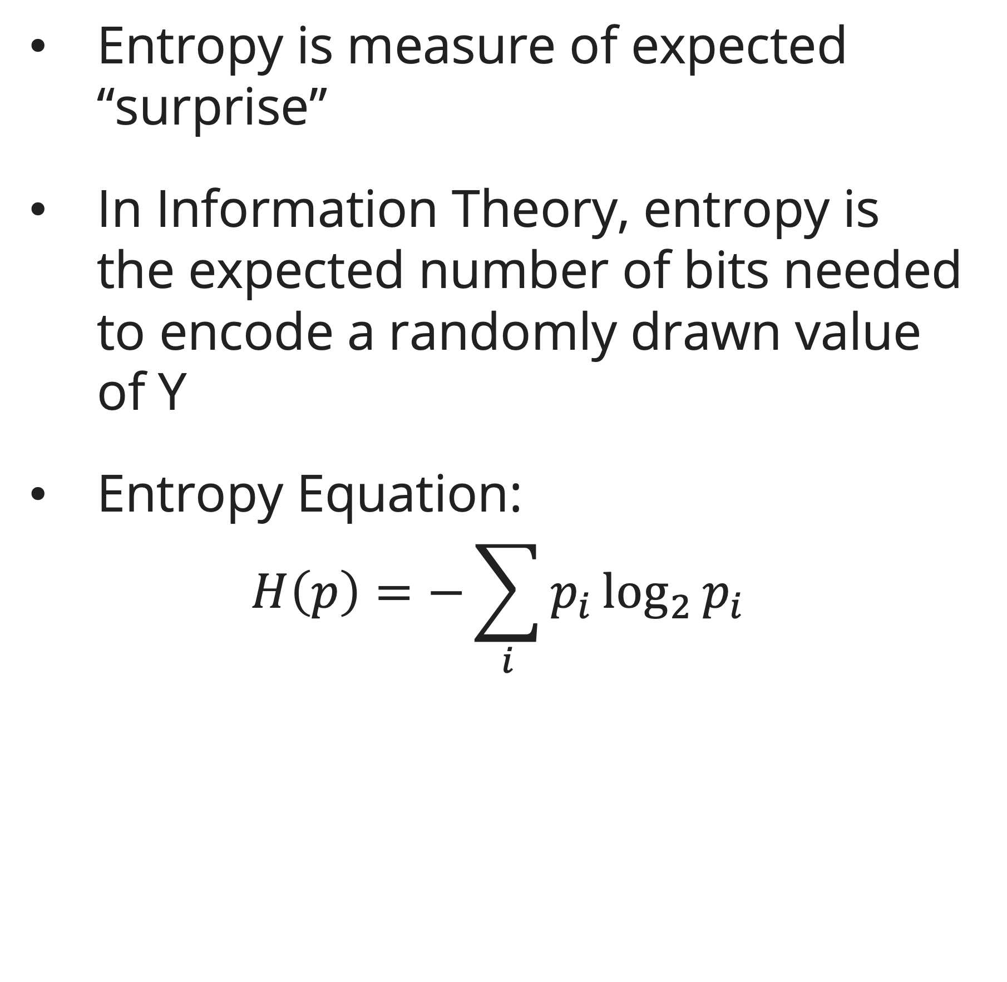
Decision tree
ID3 Algorithm: entropy
  Entropy is measure of expected “surprise”
  In Information Theory, entropy is the expected number of bits needed to encode a randomly drawn value of Y
  Entropy Equation:
  $$H\left(p\right)=−\sum_{i}{p_{i}}\log_{2}{p_{i}}$$

Slide 16
Decision tree
example
You are given a dataset from a university's admissions office that has been collected during the recent admissions cycle.
The dataset includes various attributes such as the applicants' GPA (Good, Mid, Bad), scores from a psychological test (High, Mid, Low), outcomes of personal interviews (Good, Bad), and the final decision on whether the applicant was accepted (Y for Yes, N for No).
No | GPA | Psy. test | Interview | Accept
1 | Good | High | Good | Y
2 | Good | Mid | Good | Y
3 | Good | Mid | Bad | Y
4 | Good | Low | Bad | N
5 | Mid | High | Good | Y
6 | Mid | Mid | Good | Y
7 | Mid | Low | Bad | N
8 | Bad | Low | Bad | N
9 | Bad | High | Good | Y
10 | Bad | Mid | Bad | N

Slide 17
Decision tree
example
As a data analyst at the university, your task is to develop a decision tree model using the ID3 algorithm that can predict the likelihood of future applicants being accepted based on the patterns found in the historical data.
The model should help streamline the decision-making process and provide transparent criteria for admissions.
No | GPA | Psy. test | Interview | Accept
1 | Good | High | Good | Y
2 | Good | Mid | Good | Y
3 | Good | Mid | Bad | Y
4 | Good | Low | Bad | N
5 | Mid | High | Good | Y
6 | Mid | Mid | Good | Y
7 | Mid | Low | Bad | N
8 | Bad | Low | Bad | N
9 | Bad | High | Good | Y
10 | Bad | Mid | Bad | N

Slide 18
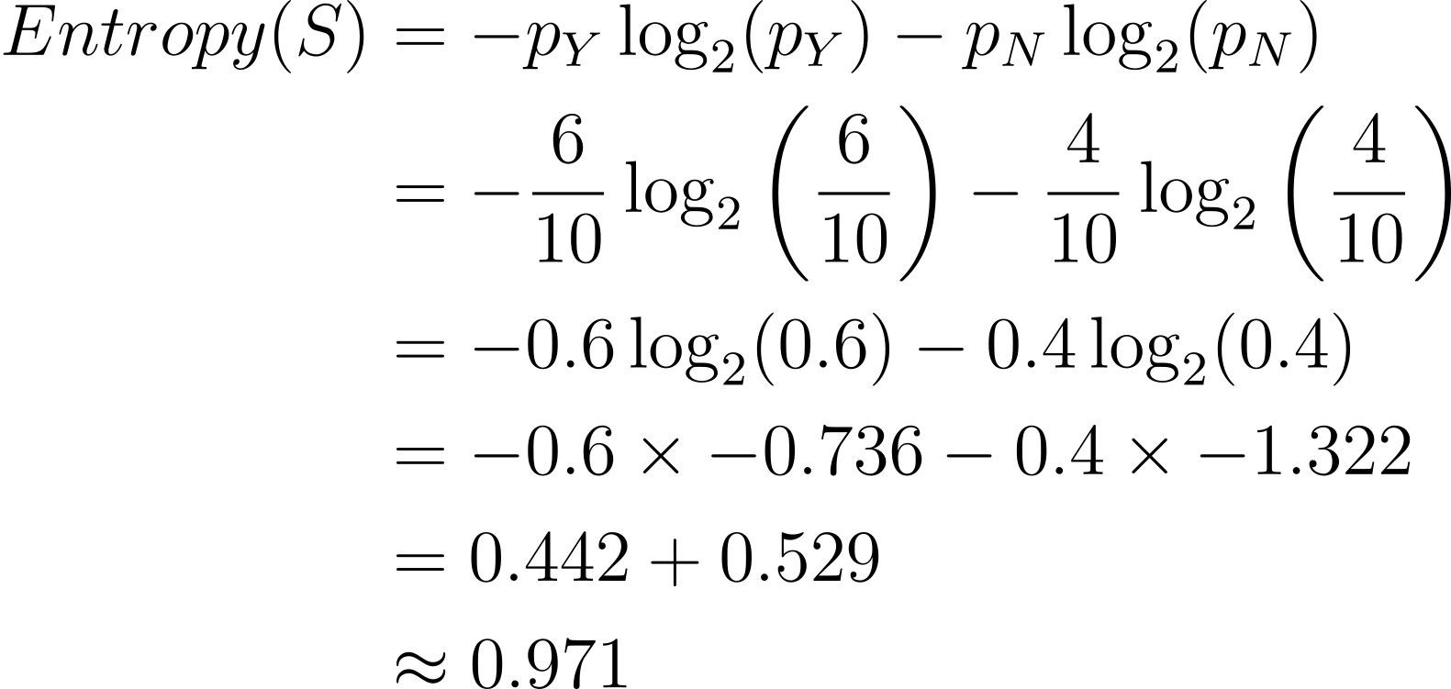
Decision tree
example
Finding the Entropy value of the target in this example the target is acceptance:
The result of the table:
The Entropy of the Target:
 | Y | N
Frequency | 6 | 4
Probability | 0.6 | 0.4

Slide 19
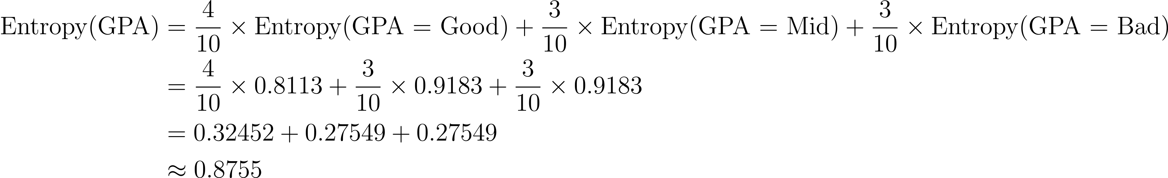
Decision tree
example
Finding the Information Gain, for each features:
  Information Gain for GPA
    First, we need to calculate the weighted entropy, here we will need Entropy(GPA=Good), Entropy(GPA=Mid), Entropy(GPA=Bad)

Slide 20
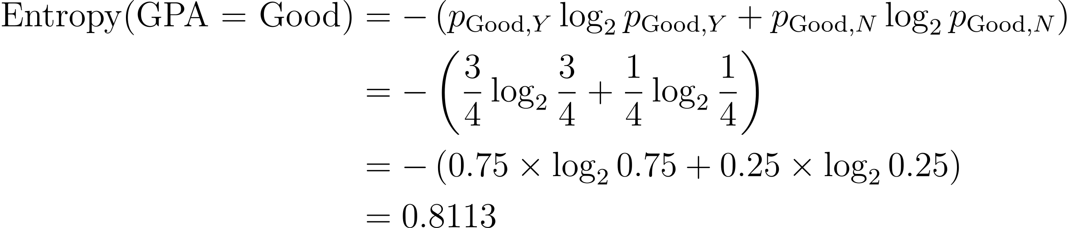
Decision tree
example
Finding the Information Gain, for each features:
  Information Gain for GPA
    The entropy value for Good value, with class (Y:3 , N: 1)

Slide 21
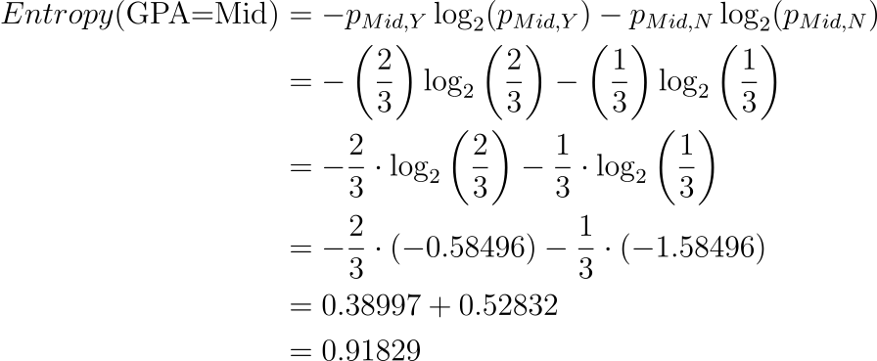
Decision tree
example
Finding the Information Gain, for each features:
  Information Gain for GPA
    The entropy value for Mid value, with class (Y:2 , N: 1)

Slide 22
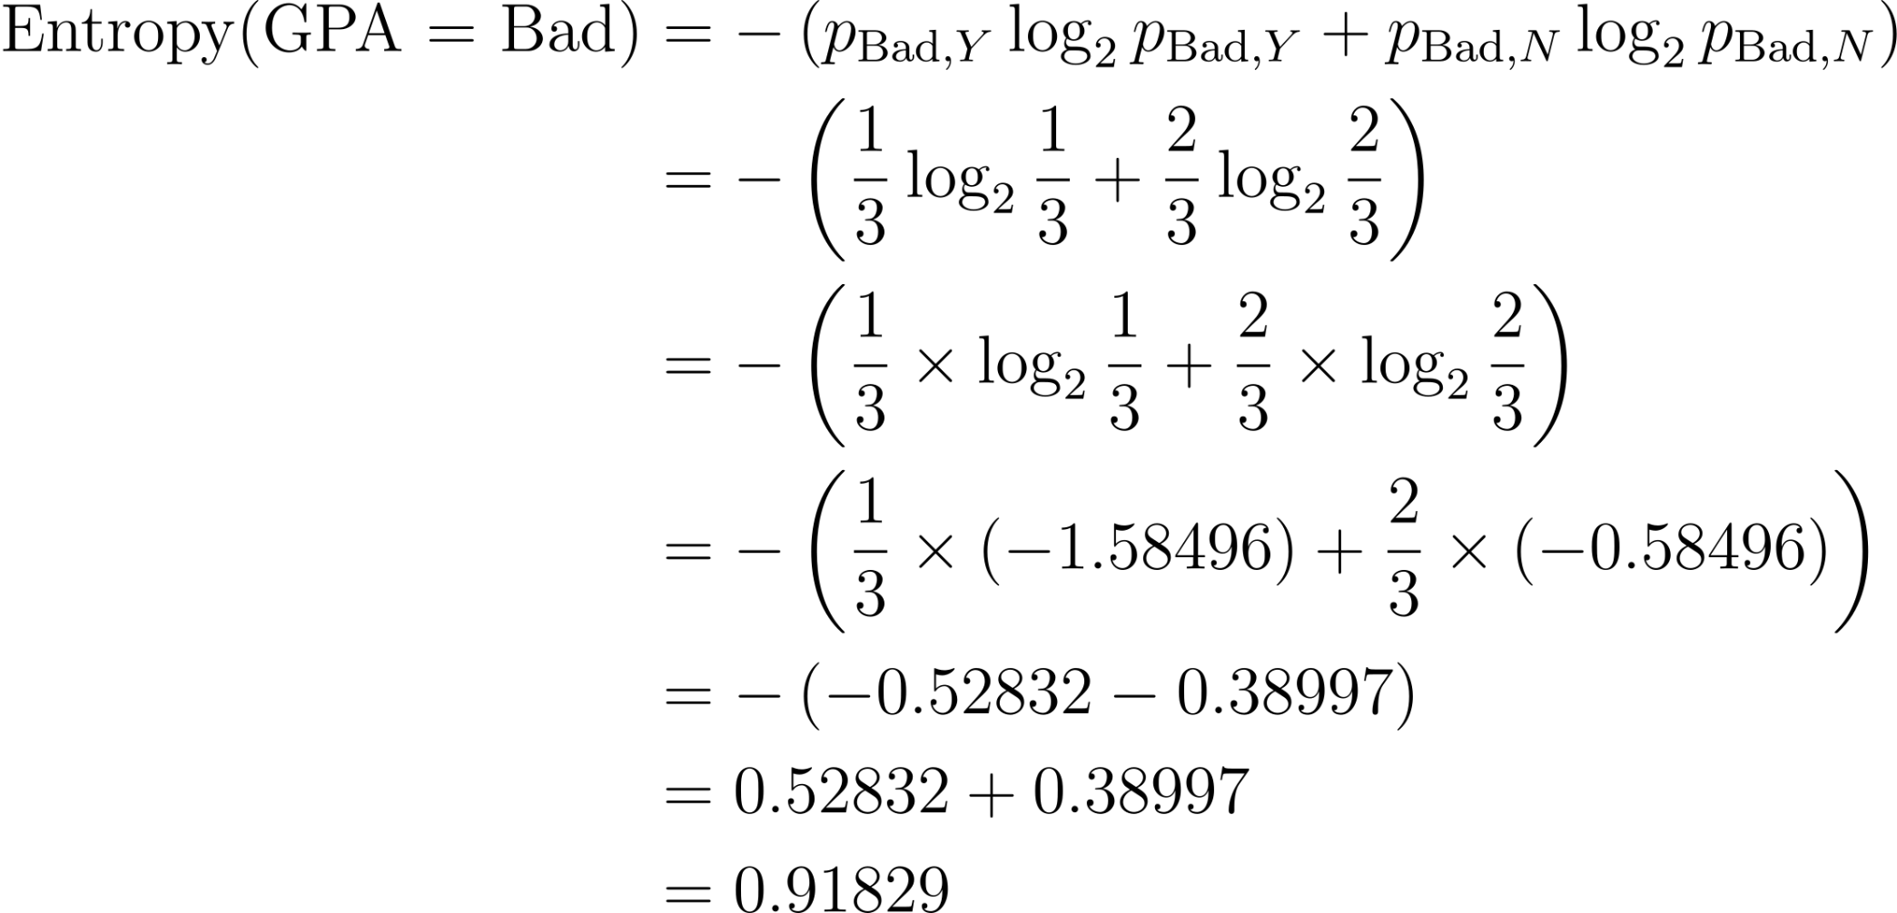
Decision tree
example
Finding the Information Gain, for each features:
  Information Gain for GPA
    The entropy value for Bad value, with class (Y:1 , N: 2)

Slide 23
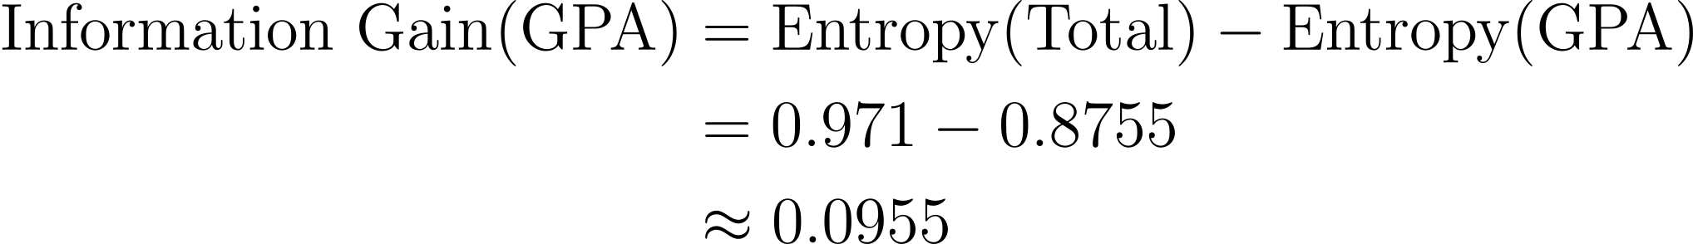
Decision tree
example
Finding the Information Gain, for each features:
  Information Gain for GPA
    We continue to calculate the weighted entropy:
    Then, calculate the Information Gain of GPA:

Slide 24
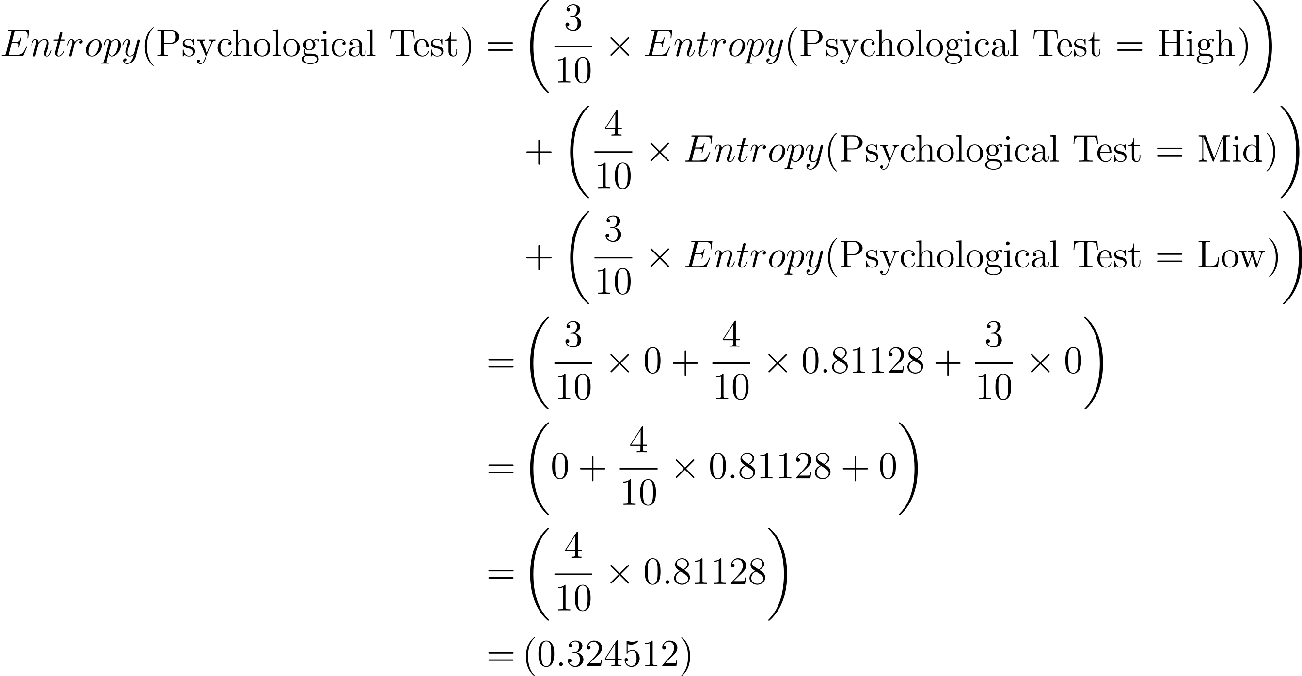
Decision tree
example
Finding the Information Gain, for each features:
  Information Gain for Psychological Test
    First, we need to calculate the weighted entropy:

Slide 25
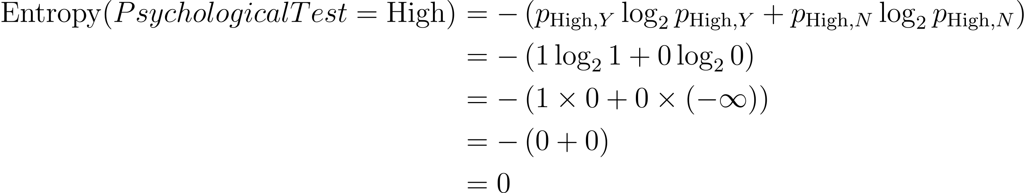
Decision tree
example
Finding the Information Gain, for each features:
  Information Gain for Psychological Test
    The entropy value for High value, with class (Y:3 , N: 0)

Slide 26
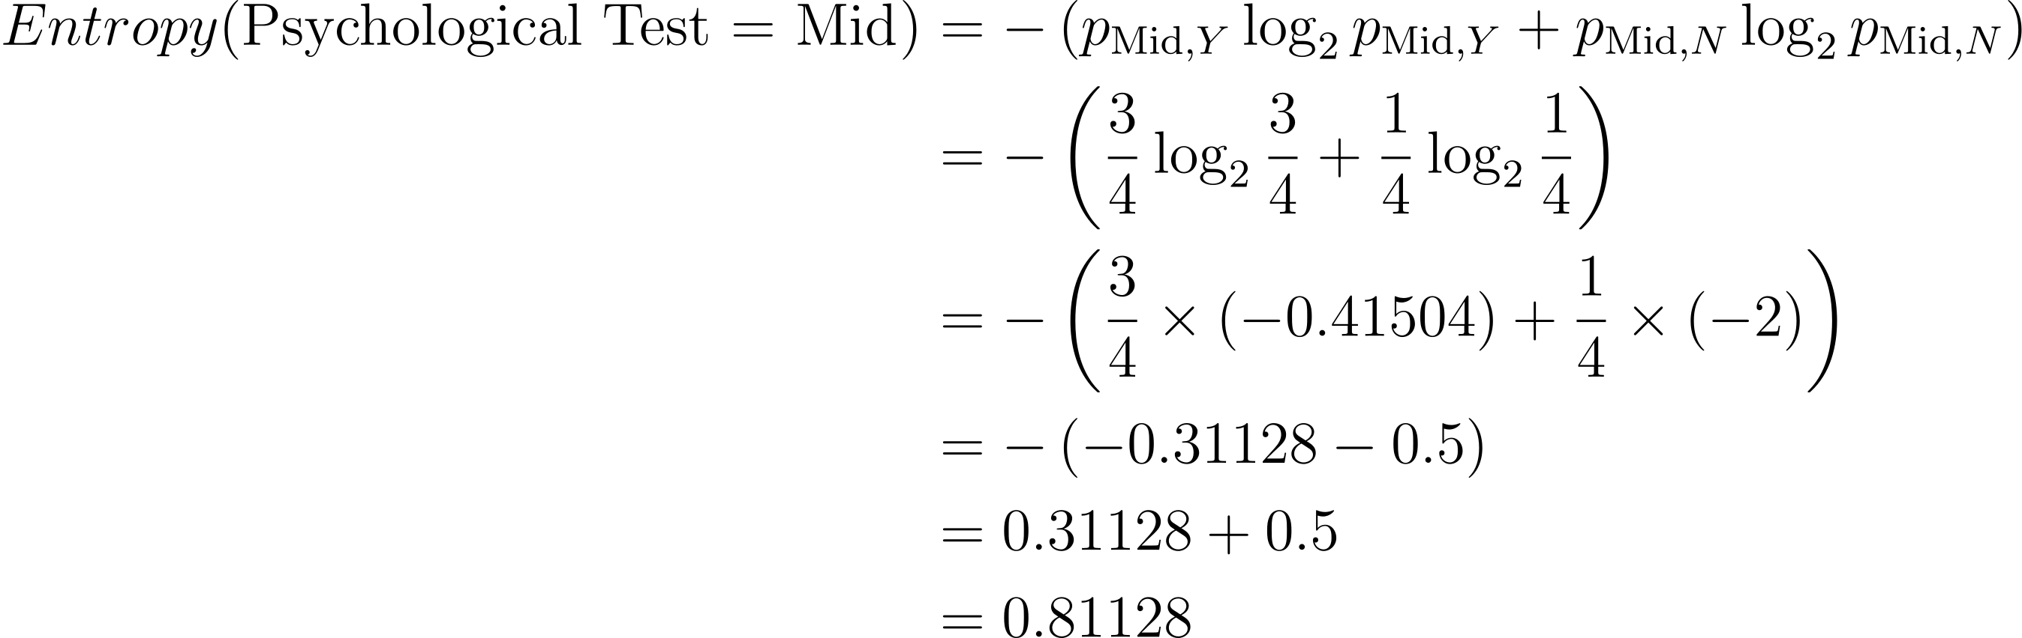
Decision tree
example
Finding the Information Gain, for each features:
  Information Gain for Psychological Test
    The entropy value for Mid value, with class (Y:3 , N: 1)

Slide 27
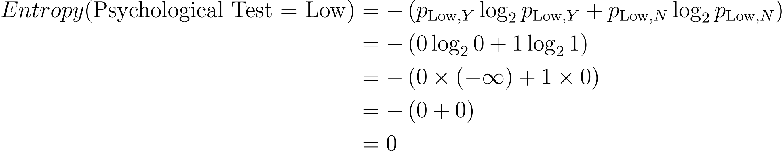
Decision tree
example
Finding the Information Gain, for each features:
  Information Gain for Psychological Test
    The entropy value for Mid value, with class (Y:0 , N: 3)

Slide 28
Decision tree
example
Finding the Information Gain, for each features:
  Information Gain for Psychological Test:
    We continue to calculate the weighted entropy:

Slide 29
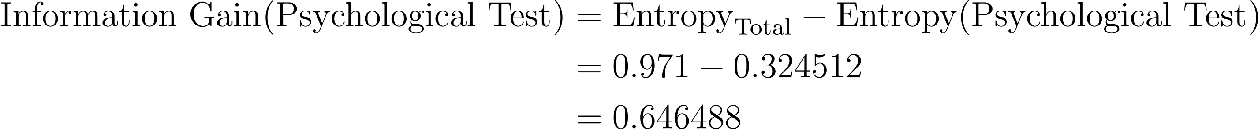
Decision tree
example
Finding the Information Gain, for each features:
  Information Gain for Psychological Test:
    Then calculate the Information Gain

Slide 30
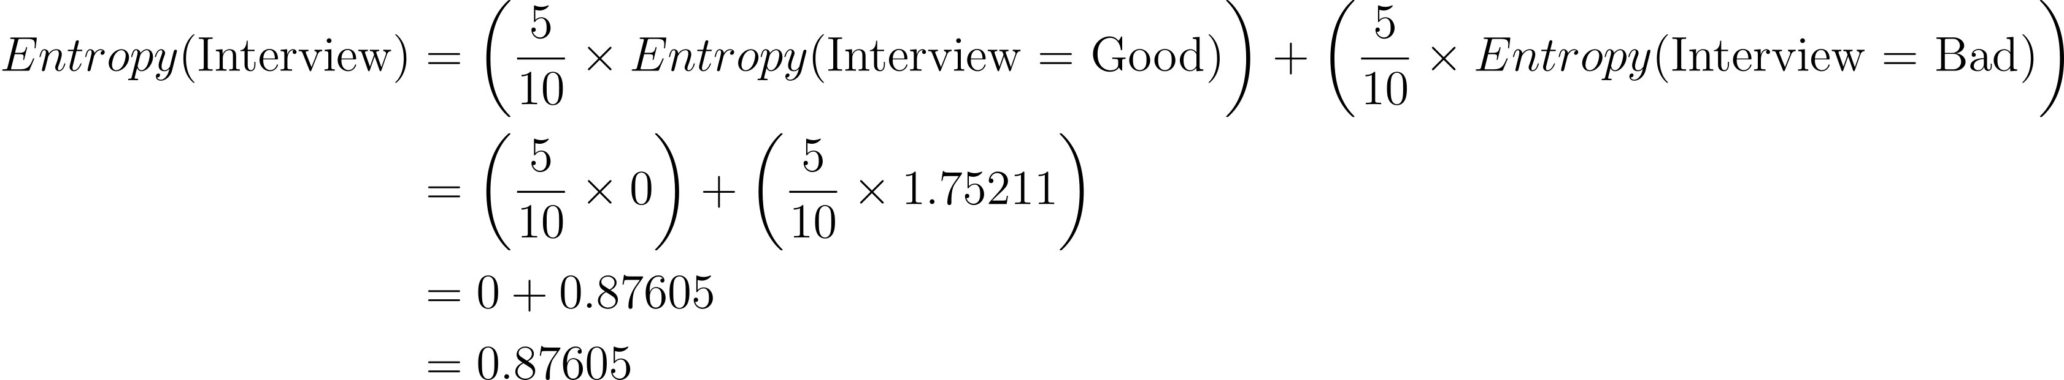
Decision tree
example
Finding the Information Gain, for each features:
  Information Gain for Interview
    First, we need to calculate the weighted entropy:

Slide 31
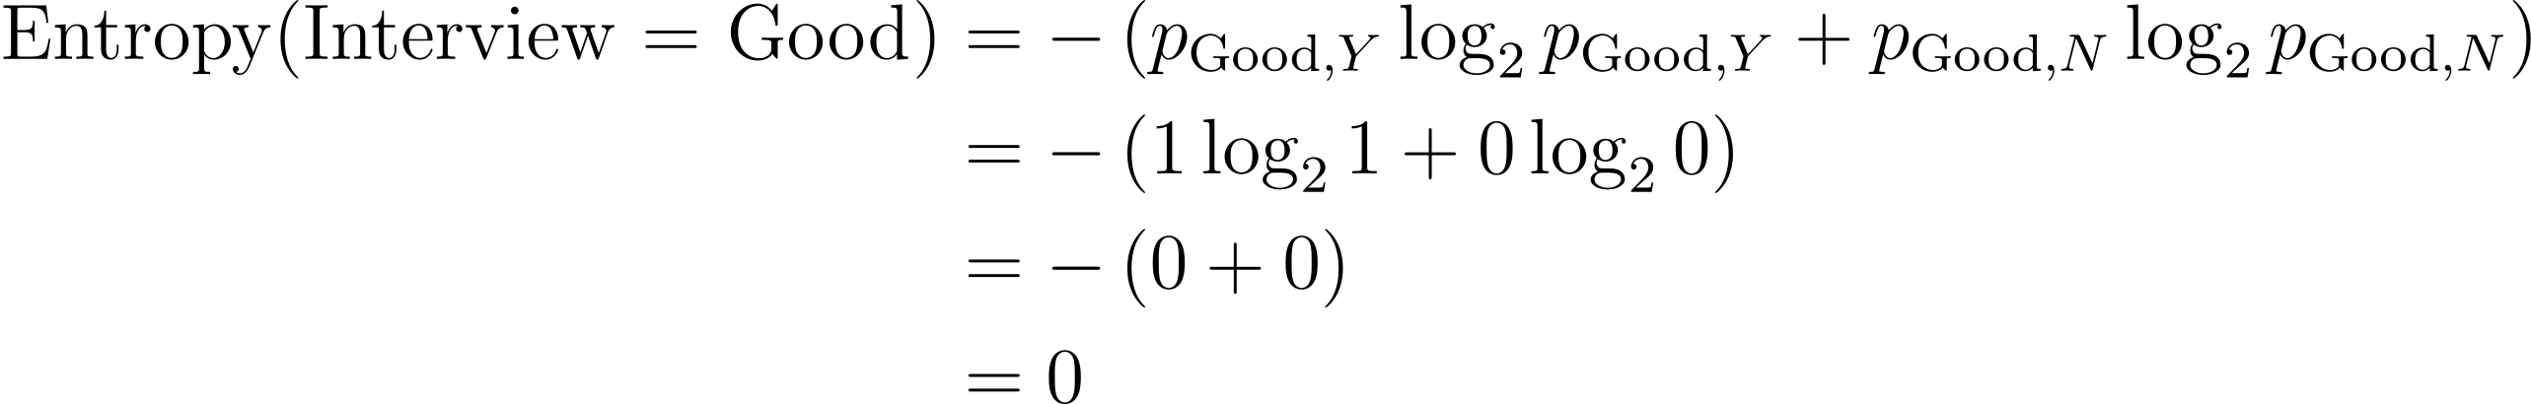
Decision tree
example
Finding the Information Gain, for each features:
  Information Gain for Interview
    The entropy value for Good value, with class (Y:5 , N: 0)

Slide 32
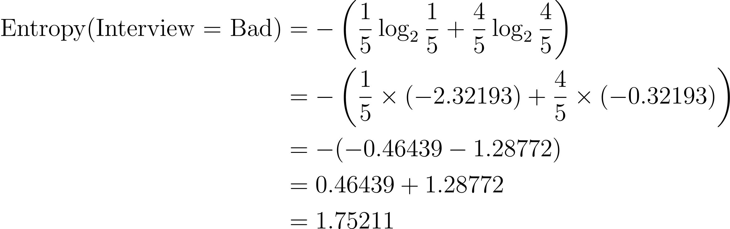
Decision tree
example
Finding the Information Gain, for each features:
  Information Gain for Interview
    The entropy value for Bad value, with class (Y:1 , N: 4)

Slide 33
Decision tree
example
Finding the Information Gain, for each features:
  Information Gain for Psychological Test:
    We continue to calculate the weighted entropy:

Slide 34
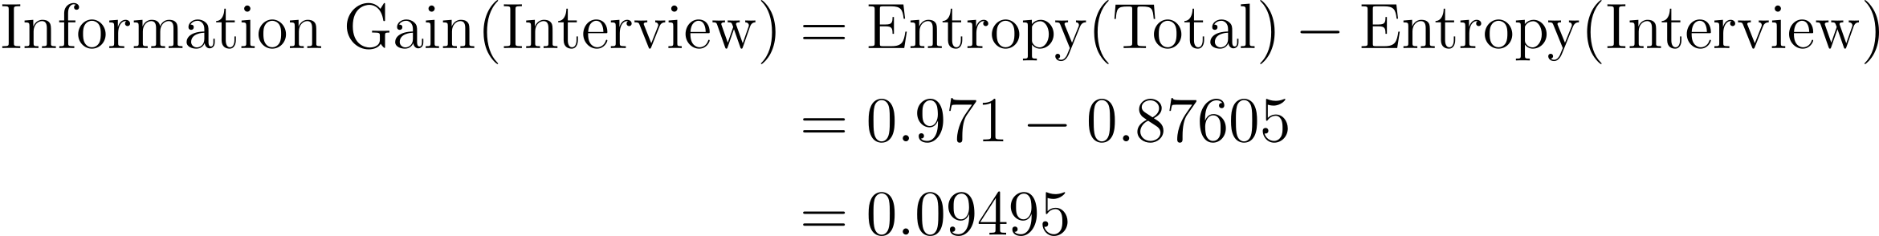
Decision tree
example
Finding the Information Gain, for each features:
  Information Gain for Psychological Test:
    Then calculate the Information Gain

Slide 35

Decision tree
example
Next, we look for the largest information gain and will be used as the root in the tree.
In the Psychological Test, High and Low, can be determined directly yes and no because the Entropy value of $H\left(Psychological Test=High\right)$ and $H\left(Psychological Test=Low\right)$ are 0.
Features | Information Gain
GPA | 0.0955
Psychological Test | 0.6465
Interview | 0.0950

Slide 36
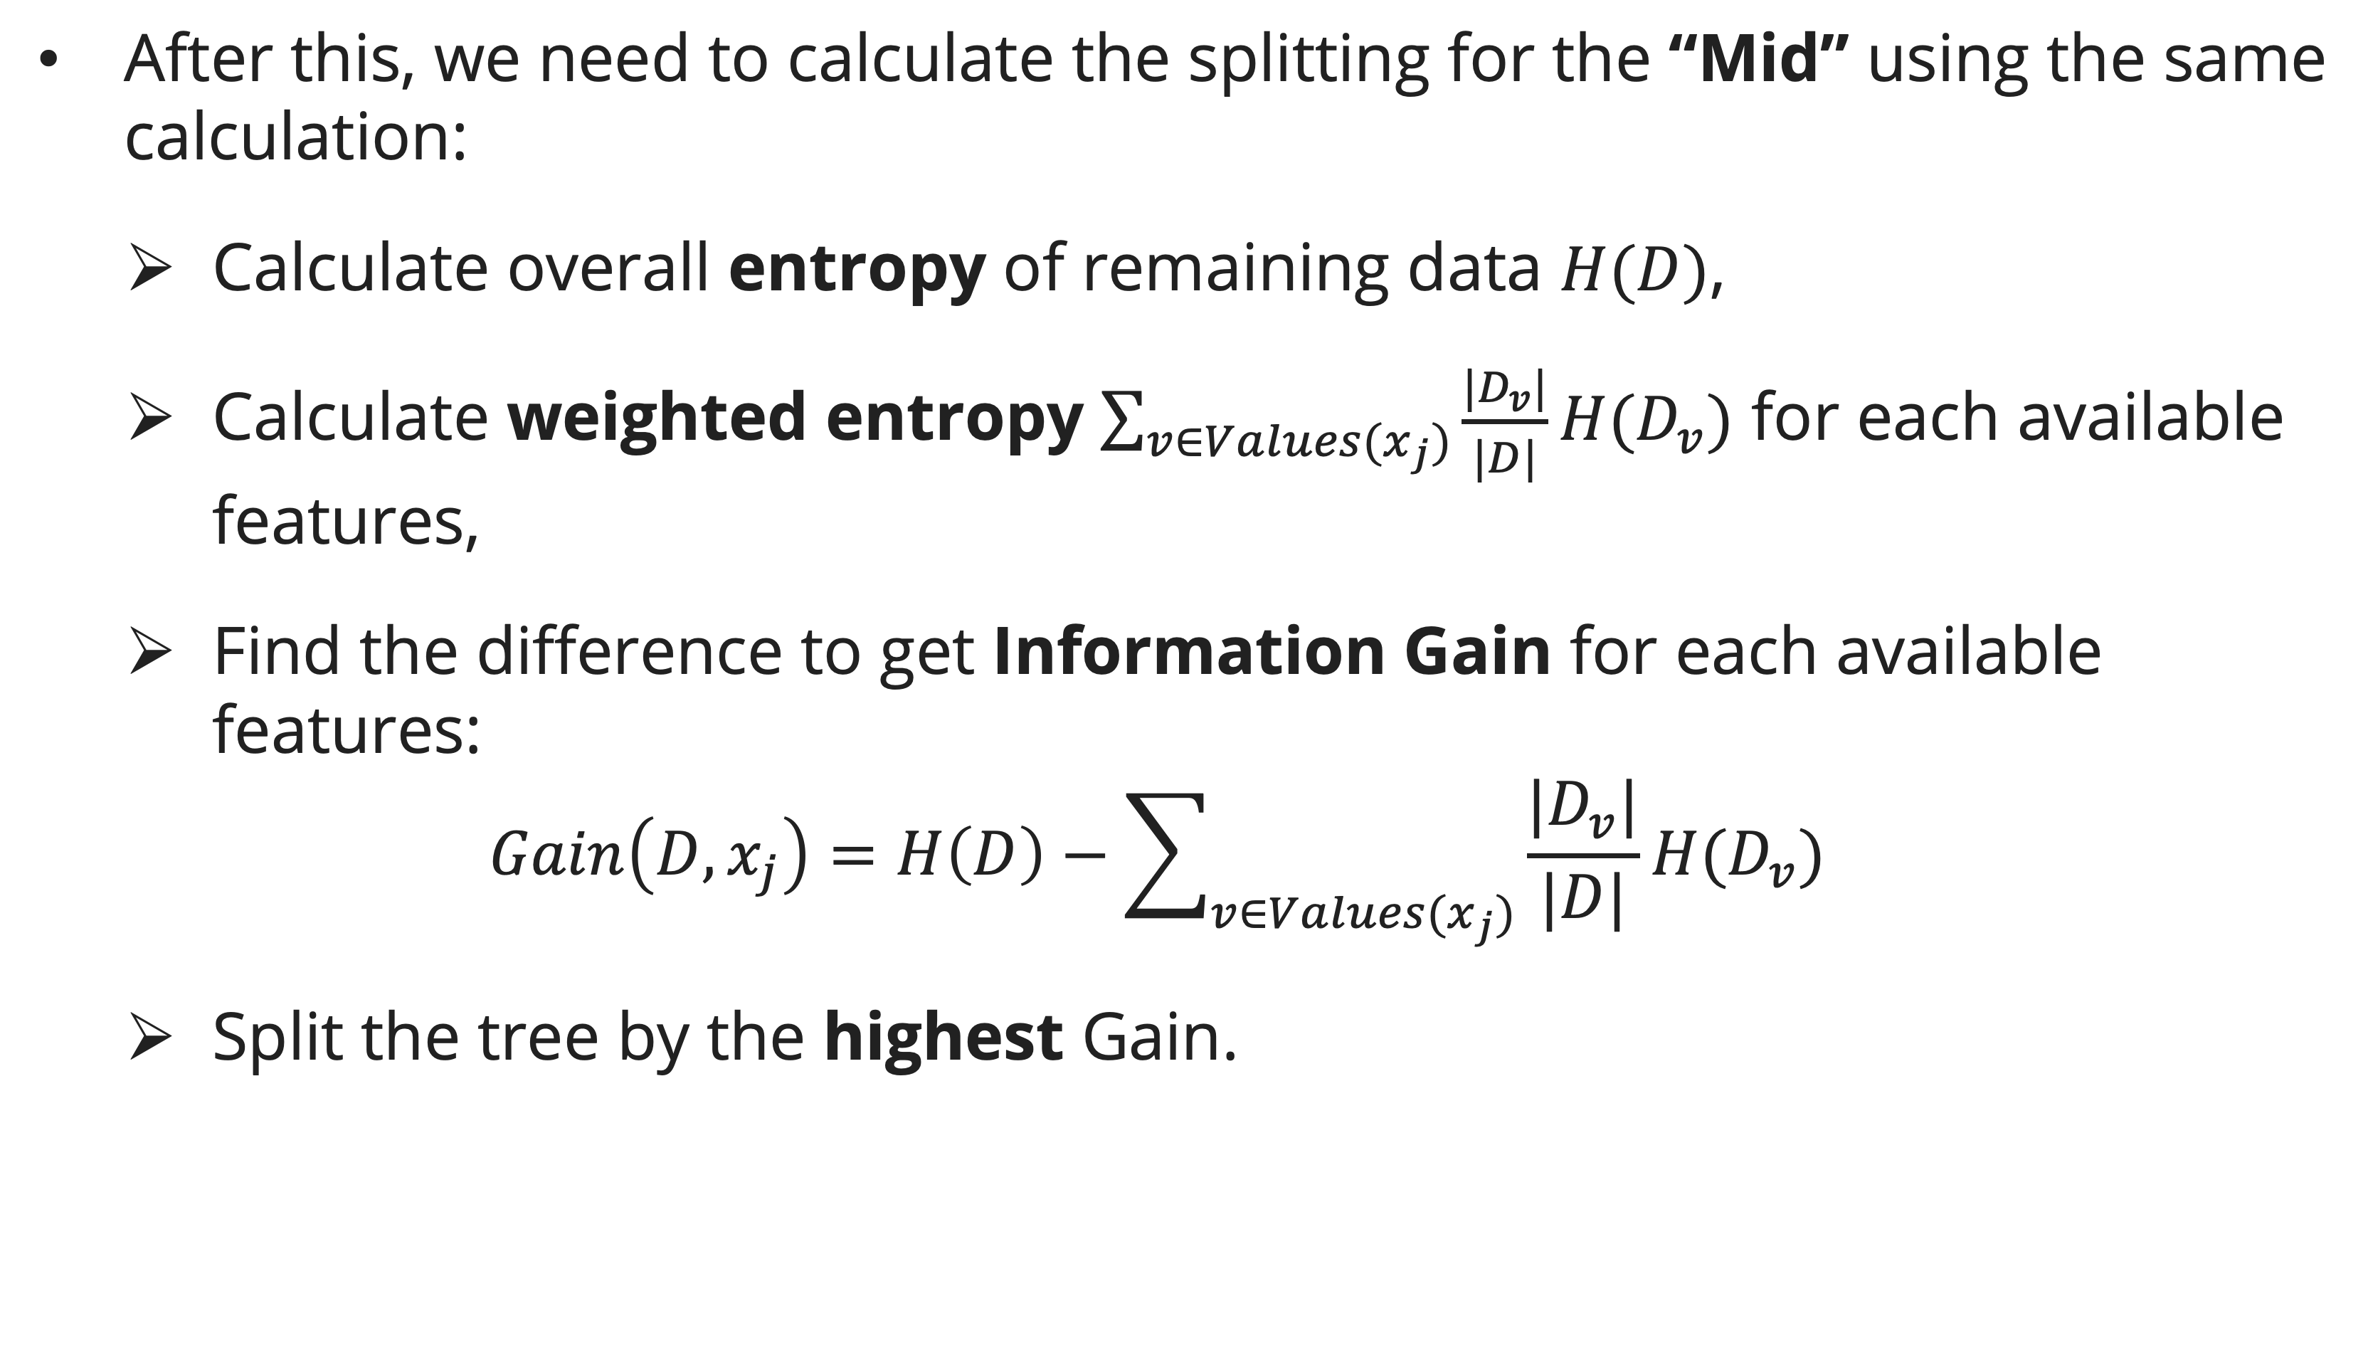
Decision tree
example
After this, we need to calculate the splitting for the “Mid” using the same calculation:
  Calculate overall entropy of remaining data $H(D)$,
  Calculate weighted entropy $\sum_{v∈Values(x_{j})}{\frac{|D_{v}|}{|D|}H(D_{v})}$ for each available features,
  Find the difference to get Information Gain for each available features:
  $$Gain\left(D, x_{j}\right)=H\left(D\right)−\sum_{v∈Values(x_{j})}{\frac{|D_{v}|}{|D|}H(D_{v})}$$
  Split the tree by the highest Gain.

Slide 37
Exercise
Tennis playing
Given the table displaying various weather conditions, including Outlook, Temperature, Humidity, and Wind, determine whether it is advisable to play tennis under each set of conditions. Use the ID3 algorithm to construct a decision tree that models the decision-making process
Outlook | Temp | Humidity | Wind | Play Tennis
Sunny | Hot | High | Weak | No
Sunny | Hot | High | Strong | No
Overcast | Hot | High | Weak | Yes
Rain | Mild | High | Weak | Yes
Rain | Cool | Normal | Weak | Yes
Rain | Cool | Normal | Strong | No
Overcast | Cool | Normal | Strong | Yes
Sunny | Mild | High | Weak | No
Sunny | Cool | Normal | Weak | Yes
Rain | Mild | Normal | Weak | Yes

Slide 38
References
Session 21
Peter Norvig, Stuart Russel. (2021). Artificial Intelligence: A Modern Approach. Pearson. London. ISBN: 978-1292401133. Ch. 19-20.
Grosse, R., Farahmand, A., & Carrasquilla, J. (2018). Decision Trees. CSC 411 Fall 2018 Machine Learning and Data Mining. https://www.cs.toronto.edu/~rgrosse/courses/csc411_f18/slides/lec03-slides.pdf
Pearson, J. (2020). Lecture 8: Decision Trees. Introduction to Machine Learning (1DL034). https://user.it.uu.se/~justin/Assets/Teaching/IntroML/Slides/lecture8.pdf
Raschka, S. (2018). Lecture 6: Decision Trees. STAT 479 -- Machine Learning (Fall 2018). https://sebastianraschka.com/pdf/lecture-notes/stat479fs18/06_trees_notes.pdf

